Slide 1

Scrapbook
Aline Câmara de Oliveira

Slide 2
Index
Complicated
My name is
My mother
Growing up
Today, almost a big woman
Religion
Parents and stepfather
Friends and boyfriend
Nowadays
The last one

Slide 3
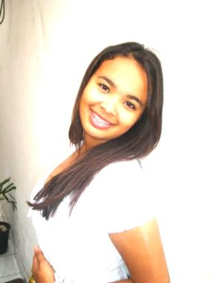
Complicate
&
Perfect
Aline Câmara
Tucano

Slide 4
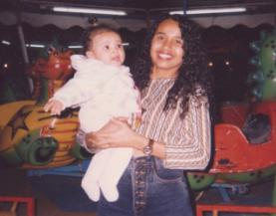
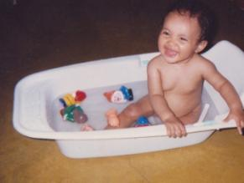
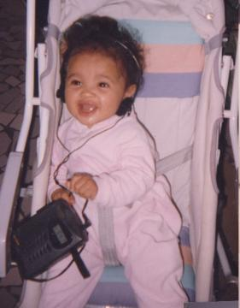
My name is Aline Câmara and I ‘m fifteen years old.
Being here was not easy, but I'm happy the way I am, because I have a family that always loved me very much.

Slide 5
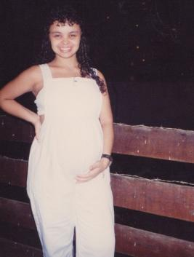
My mother got pregnant at my age, that’s why she understands me very well, and she gives me a lot of advice.
She is a big woman, the best mother of the world!

Slide 6

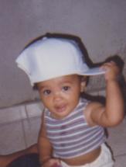

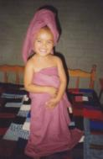
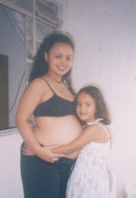
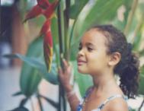

The little girl grew up…
… she cried many times…
…and learned from her mistakes.

Slide 7

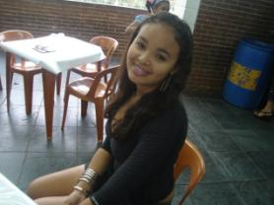
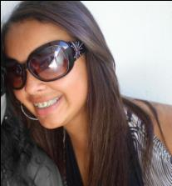
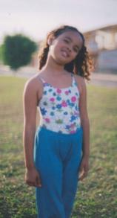

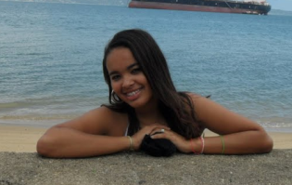
... and today, the child
Is almost a woman…
…with dreams and goals.

Slide 8
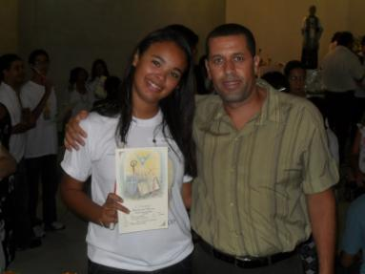
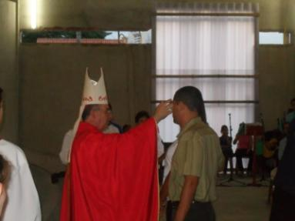
God has always been and always will be present in my life, without HIM I am nothing.
Photos of Catholicism confirmation.

Slide 9
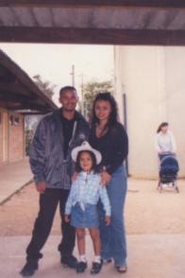
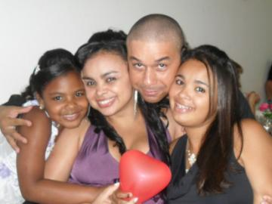
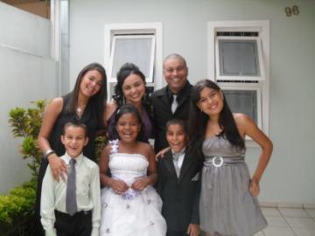
My parents are divorced, and I live with my mother.
Mother and father
My sister and I have a nice stepfather. I love them.

Slide 10
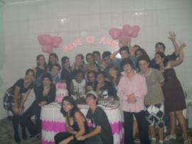
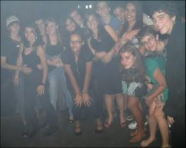
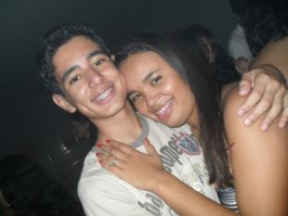
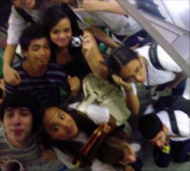
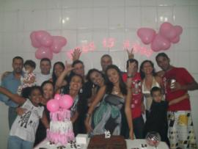
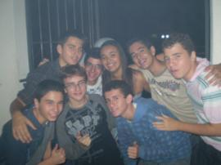
I’m very happy, because I have many good friends and a boyfriend.
I like to have fun with my friends.

Slide 11
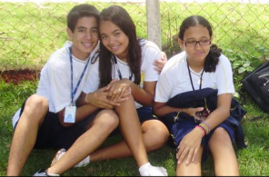
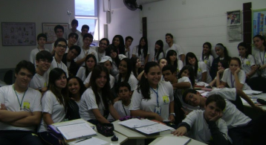
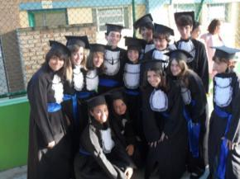
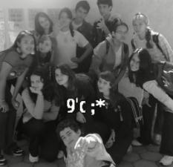
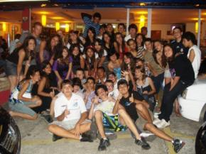
I study at Embraer High School, where
I made many friends...
…but I miss my old friends.

Slide 12

This is me ...
…a girl who wants to be happy, and is writing her story.
Kisses Aline

